Slide 1
INTRO TO JSP AND SERVLETS

Slide 2
JAVA SERVLET

Slide 3
Java Servlets
    “A servlet is a Java™ technology-based Web component, managed by a container, that generates dynamic content.
    Like other Java-based components, Servlets are platform-independent Java classes that are compiled to platform-neutral byte code that can be loaded dynamically into and run by a java-enabled web server.
Java Servlet specification defines an API for communication between the Web/application server and application program running in the server
  E.g., methods to get parameter values from Web forms, and to send HTML text back to client

Slide 4
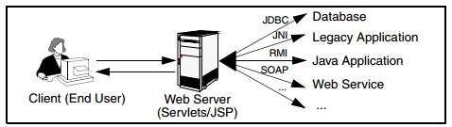
Servlets
Servlets are Java programs that run on Web or application servers, acting as middle layer between requests coming from Web browser (HTTP) and application (database) on the HTTP server

Slide 5
Java Servlets
What is a Servlet Container?
  “The servlet container is a part of a Web server or application server that provides the network services over which requests and responses are sent, decodes MIME-based requests, and formats MIME-based responses”
  A servlet container also contains and manages servlets through their lifecycle.”
  Java Servlet Containers
    Apache Tomcat
    BEA WebLogic Server
    IBM WebSphere Application Server
    JBoss Application Server
    Oracle Application Server
    Glassfish

Slide 6
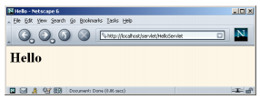
Java Servlet Example: HelloServlet.java
import java.io.*;
import javax.servlet.*;
import javax.servlet.http.*;
public class HelloServlet extends HttpServlet {
  public void doGet(HttpServletRequest request, HttpServletResponse response)
  throws ServletException, IOException {
  response.setContentType("text/html");
  PrintWriter out = response.getWriter();
  String docType = "<!DOCTYPE HTML PUBLIC \"-//W3C//DTD HTML 4.0 " +
  "Transitional//EN\">\n";
  out.println(docType +
    "<HTML>\n" +
    "<HEAD><TITLE>Hello</TITLE></HEAD>\n" +
    "<BODY BGCOLOR=\"#FDF5E6\">\n" +
    "<H1>Hello</H1>\n" +
    "</BODY></HTML>");
  }
  }

Slide 7
Example Servlet Code: request and response OBJECTS
import java.io.*;
import javax.servlet.*;
import javax.servlet.http.*;
public class PersonQueryServlet extends HttpServlet {
public void doGet (HttpServletRequest request, HttpServletResponse response)
throws ServletException, IOException
{
response.setContentType("text/html");
PrintWriter out = response.getWriter();
out.println("<HEAD><TITLE> Query Result</TITLE></HEAD>");
out.println("<BODY>");
….. BODY OF SERVLET (next slide) …
out.println("</BODY>");
out.close();
}
}

Slide 8
Example Servlet Code: request and response OBJECTS
String persontype = request.getParameter("persontype");
String number = request.getParameter("name");
if(persontype.equals("student")) {
... code to find students with the specified name ...
... using JDBC to communicate with the database ..
out.println("<table BORDER COLS=3>");
out.println(" <tr> <td>ID</td> <td>Name: </td>" + " <td>Department</td> </tr>");
for(... each result ...){
... retrieve ID, name and dept name
... into variables ID, name and deptname
out.println("<tr> <td>" + ID + "</td>" + "<td>" + name + "</td>" + "<td>" + deptname
+ "</td></tr>");
};
out.println("</table>");
}
else {
... as above, but for instructors ...
}

Slide 9
Servlet: Typical Sequence of Events
A client (e.g., a Web browser) accesses a Web server and makes an HTTP request.
The request is received by the Web server and handed off to the servlet container. The servlet container can be running :
  in the same process as the host web server,
  in a different process on the same host, or
  on a different host from the web server for which it processes requests.
The servlet container determines which servlet to invoke based on the configuration of its servlets, and calls it with objects representing the request and response.
  Web.xml configuration file (URLs to Java Servlet code)
The servlet uses the request object to find out who the remote user is, what HTTP POST parameters may have been sent as part of this request, and other relevant data.
  The servlet performs whatever logic it was programmed with, and generates data to send back to the client. It sends this data back to the client via the response object.
Once the servlet has finished processing the request, the servlet container ensures that the response is properly flushed, and returns control back to the host Web server.

Slide 10
Servlet Sessions
Servlet API supports handling of sessions
  Sets a cookie on first interaction with browser, and uses it to identify session on further interactions
To check if session is already active:
  if (request.getSession(false) == true)
    .. then existing session
    else .. redirect to authentication page
  authentication page
    check login/password
    request.getSession(true): creates new session
Store/retrieve attribute value pairs for a particular session
  session.setAttribute(“userid”, userid)
  session.getAttribute(“userid”)

Slide 11
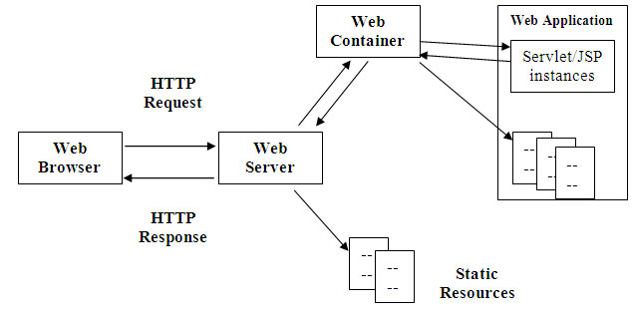
Web Servers
Outputs and receives HTML

Slide 12
SERVER-SIDE SCRIPTING
JSP

Slide 13
Server-Side Scripting
Server-side scripting simplifies the task of connecting a database to the Web
  Define an HTML document with embedded executable code/SQL queries.
  Input values from HTML forms can be used directly in the embedded code(SQL queries).
  When the document is requested, the Web server executes the embedded code to generate the actual HTML document.
Numerous server-side scripting languages
  JSP, PHP
  General purpose scripting languages: VBScript, Perl, Python

Slide 14
JSP
JSP is HTML pages with Java code embedded inside of them
  a JSP document is just another way of writing a servlet.
  JSP pages get translated into servlets, the servlets get compiled, and it is the servlets that run at request time.
JSP And Servlets are essentially the same thing
  JSP is focused on simplifying the creation and maintenance of the HTML.
  Servlets are best at invoking the business logic and performing complicated operations.
  A quick rule of thumb is that servlets are best for tasks oriented toward processing, whereas JSP is best for tasks oriented toward presentation
“You can think of servlets as Java code with HTML inside”
“you can think of JSP as HTML with Java code inside”

Slide 15
JSP Programming
To make JSP page more interactive we can read and process the data entered in a an HTML form.
  request.getParameter method
    Takes the name of the HTML field name as parameter
    Returns the value entered by the user
    String authorName = request.getParameter (“AuthorName”);

Slide 16
Java Server Pages (JSP)
A JSP page with embedded Java code
<html>
<head> <title> Hello </title> </head>
<body>
<% if (request.getParameter(“name”) == null)
{ out.println(“Hello World”); }
else
{ out.println(“Hello, ” + request.getParameter(“name”)); }
%>
</body>
</html>
JSP is compiled into Java + Servlets

Slide 17
JSP Programming
JSP Elements
  All of these elements are identified by their own tags
  Declarations
    These tags allows you to define variables and methods
    <%!
      private int count = 0;
      private void increments () { count ++;}
    %>
  Expressions
    We can access variables and methods
    <p> The value of Count is : <%= count %> </p>
  Scriptlets
    Blocks of Java code
    <% out.println (“Hello Students”); %> //out is already defined in javax.servlet.jsp.JspWriter
    <%
      out.println(“The counter =“ + count + <br />);
      incrementCount();
    %>
  Directives
    Instructions on how to process a JSP program (Importing packages)
    <%@ page import=“java.util.*,java.sql.*” %>

Slide 18
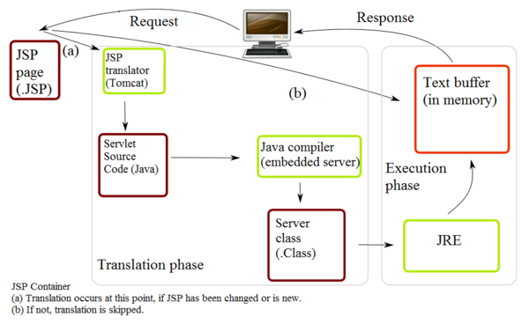
Running JSP Program
JSP Servlets Engine
  JSP/Servlet engine dynamically compiles the JSP source code into Servlet if a current compiled Servlet does not exist

Slide 19
STATIC JSP DEMO

Slide 20
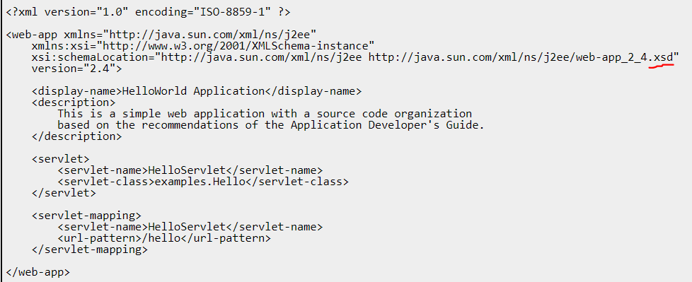
Sample web.xml File
In the preceding web.xml deployment descriptor file:
  <servlet> XML element declares the HelloServlet,
    the examples.Hello Java class implements the servlet,
  <servlet-mapping> XML element specifies the /hello URL pattern that invokes the servlet in a browser.
    This URL pattern is used in the index.html file.

Slide 21
Java Source of the Hello.java Servlet
package examples;
import java.io.IOException; import java.io.PrintWriter;
import javax.servlet.ServletException; import javax.servlet.http.HttpServlet;
import javax.servlet.http.HttpServletRequest;
import javax.servlet.http.HttpServletResponse;
public final class Hello extends HttpServlet {
public void doGet(HttpServletRequest request, HttpServletResponse response)
throws IOException, ServletException {
response.setContentType("text/html");
PrintWriter writer = response.getWriter();
writer.println("<html>");
writer.println("<head>");
writer.println("<title>Sample Application Servlet Page</title>");
writer.println("</head>");
writer.println("<body bgcolor=white>");
  writer.println("<h1>Sample Application Servlet</h1>");
writer.println("This is the output of a servlet that is part of");
writer.println("the Hello, World application.");
writer.println("</body>");
writer.println("</html>");
}
}
Notes:
Description of the Hello Servlet
In the preceding code:
The Hello class extends the javax.servlet.http.HttpServlet abstract class. This abstract class provides a framework for handling the HTTP protocol. When extending the HttpServletabstract class, a programmer must override at least one method, depending on the type of requests the servlet supports, such as HTTP GET, HTTP POST, and so on.
The Hello servlet overrides the doGet method because it supports HTTP GET. The parameters of the method are the HTTP request and response.
The response.setContentType method tells the receiver of the response (such as a browser) that the response type is text/html, or simple HTML.
The response.getWriter method returns a PrintWriter object used to send character text to the client, in this case a browser. The writer.println lines build an HTML file that will be rendered by the browser that invokes the servlet.

Slide 22
JSP Source for the hello.jsp JSP
<html>
<head>
<title>Sample Application JSP Page</title>
</head>
  <h1>Sample Application JSP Page</h1>
  <p>This is the output of a JSP page that is part of the HelloWorld application.</p>
<%= new String("Hello!") %>
</body>
</html>
The hello.jsp includes the following simple JSP directive:
<%= new String("Hello!") %>
This JSP directive simply prints out a message to the client (browser): Hello!
Notes:
The hello.jsp page is a static HTML page embedded with a JSP command. A JSP command is an XML-like snippet that encapsulates logic that dynamically generates content within the static HTML. JSP commands can include directives, declarations, expressions, actions, and blocks of Java code, all enclosed within angle-brackets, like XML elements. At compile-time, the JSP is converted into a servlet, which is what tc Runtime instance actually executes at runtime.

Slide 23
Sample Default index.html File
<html>
<head>
<title>Sample "Hello, World" Application</title>
</head>
<body>
  <h1>Sample "Hello, World" Application</h1>
  <p>This is the home page for the HelloWorld Web application. </p>
  <p>To prove that they work, you can execute either of the following links:
    <ul>
    <li>To a <a href="hello.jsp">JSP page</a>.
    <li>To a <a href="hello">servlet</a>.
    </ul>
</body>
</html>

Slide 24
PHP

Slide 25
PHP Scripting Environment
PHP is widely used for Web server scripting
Extensive libaries including for database access using ODBC
<html>
<head> <title> Hello </title> </head>
<body>
<?php
if (!isset($_REQUEST[‘name’]))
{ echo “Hello World”; }
else
{ echo “Hello, ” + $_REQUEST[‘name’]; }
?>
</body>
</html>

Slide 26
Application Architectures

Slide 27
Application Architectures
Application layers
  Presentation or user interface
    model-view-controller (MVC) architecture
      model: business logic
      view: presentation of data, depends on display device
      controller: receives events, executes actions, and returns a view to the user
  business-logic layer
    provides high level view of data and actions on data
      often using an object data model
    hides details of data storage schema
  data access layer
    interfaces between business logic layer and the underlying database
    provides mapping from object model of business layer to relational model of database

Slide 28

Application Architecture

Slide 29
Business Logic Layer
Provides abstractions of entities
  e.g. students, instructors, courses, etc
Enforces business rules for carrying out actions
  E.g. student can enroll in a class only if she has completed prerequsites, and has paid her tuition fees
Supports workflows which define how a task involving multiple participants is to be carried out
  E.g. how to process application by a student applying to a university
  Sequence of steps to carry out task
  Error handling
    e.g. what to do if recommendation letters not received on time
  Workflows discussed in Section 26.2

Slide 30
Object-Relational Mapping
Allows application code to be written on top of object-oriented data model, while storing data in a traditional relational database
  alternative: implement object-oriented or object-relational database to store object model
Schema designer has to provide a mapping between object data and relational schema
  e.g. Java class Student mapped to relation student, with corresponding mapping of attributes
  An object can map to multiple tuples in multiple relations
Application opens a session, which connects to the database
Objects can be created and saved to the database using session.save(object)
  mapping used to create appropriate tuples in the database
Query can be run to retrieve objects satisfying specified predicates

Slide 31
Object-Relational Mapping and Hibernate (Cont.)
The Hibernate object-relational mapping system is widely used
  public domain system, runs on a variety of database systems
  supports a query language that can express complex queries involving joins
    translates queries into SQL queries
  allows relationships to be mapped to sets associated with objects
    e.g. courses taken by a student can be a set in Student object
The Entity Data Model developed by Microsoft
  provides an entity-relationship model directly to application
  maps data between entity data model and underlying storage, which can be relational
  Entity SQL language operates directly on Entity Data Model

Slide 32
NEXT
JAVA NETWORK DEMO1
java.net.* package
Download source code from the code folder on blackboard

